Slide 1
Passive modelocking of QCLs report
Prepared by
Petar Tzenov
Feb/28/2017

Slide 2
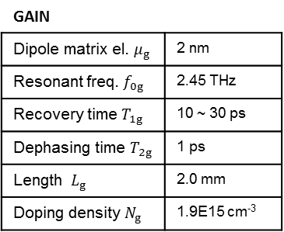
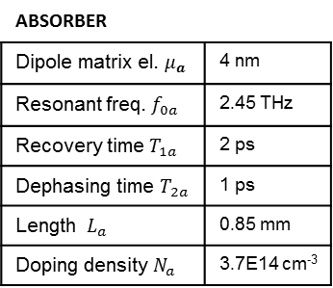
CLEO Abstract img
(a)
Absorber
Gain
Spectrum (a.u.)
8.0
(b)
1
(e)
1
Power (mW)
Inversion
ABS
GAIN
4.0
T_{1g}=30 ps
0
0.5
0
-1
0
ABSORBER
Dipole matrix el. $μ_{a}$ | 4 nm
Resonant freq. $f_{0a}$ | 2.45 THz
Recovery time$T_{1a}$ | 2 ps
Dephasing time $T_{2a}$ | 1 ps
Length $L_{a}$ | 0.85 mm
Doping density $N_{a}$ | 3.7E14 cm⁻³
GAIN
Dipole matrix el. $μ_{g}$ | 2 nm
Resonant freq. $f_{0g}$ | 2.45 THz
Recovery time $T_{1g}$ | 10 ~ 30 ps
Dephasing time $T_{2g}$ | 1 ps
Length $L_{g}$ | 2.0 mm
Doping density$N_{g}$ | 1.9E15 cm⁻³
20
(c)
1
(f)
1
Power (mW)
Inversion
10
T_{1g}=20 ps
0.5
0
0
-1
0
20
(d)
1
(g)
1
Power (mW)
Inversion
10
0
0.5
T_{1g}=10 ps
0
-1
0
0
0.5
1
1.5
2
2.5
3
-0.5
0
0.5
Length (mm)
Freq. (THz)

Slide 3







Cavity geometry
a
ABS, $T_{A}$
b
$$E_{n+1}(t)$$
$$E_{n+1}(t)$$
$$E_{n}(t)$$
GAIN
ABS
$$E_{n}(t)$$
GAIN, $T_{G}$
$$T_{G}$$
$$T_{A}$$

Slide 4
Sought-after model
pulse
loss
gain

Slide 5
T1g = 30ps; p = 1.1
a
10
-4
b
8
0.8
1
45
1
)
.
40
0.8
u
)
)
.
.
6
0.6
0.5
a
u
W
n
(
.
o
)
y
a
m
s
t
(
i
35
0.6
i
(
s
p
s
2
r
r
(
n
|
4
e
0.4
0
e
e
)
v
r
t
w
n
g
30
0.4
n
(
o
I
i
E
P
e
|
s
2
0.2
-0.5
l
25
0.2
u
P
0
0
-1
20
0
-0.4
-0.2
0
0.2
0
1
2
3
-20
-10
0
10
20
Freq. (THz)
Length (mm)
Time (ps)
c
d
7
20
45
)
s
)
6.5
18
)
p
s
W
(
p
6
16
e
(
5.5
14
m
40
m
M
(
i
H
r
t
5
12
e
y
W
w
r
4.5
10
35
e
F
o
v
4
8
p
o
e
k
c
s
3.5
6
a
e
l
r
u
e
30
n
P
3
4
P
i
2.5
2
a
2
0
25
G
1.1
1.2
1.3
1.4
1.5
1.1
1.2
1.3
1.4
1.5
p-val
p-val

Slide 6
T1g = 20ps; p=1.1
a
1
10
-3
4
1
b
40
1
)
.
)
)
u
.
.
u
W
a
.
n
(
a
m
o
)
y
(
i
s
t
(
s
i
r
r
p
s
2
|
0.5
e
2
0
e
(
20
0.5
n
)
v
r
e
w
g
t
(
n
n
E
o
I
i
|
P
e
s
l
u
P
0
0
-1
0
0
-0.4
-0.2
0
0.2
0
1
2
3
-20
-10
0
10
20
Freq. (THz)
Length (mm)
Time (ps)
c
5
100
d
35
)
s
)
)
p
s
W
(
p
e
(
m
m
M
(
i
H
r
30
t
e
y
W
w
r
e
F
o
v
p
o
e
k
25
c
s
a
e
l
r
u
e
n
P
P
i
a
0
0
20
G
1.1
1.2
1.3
1.4
1.5
1.1
1.2
1.3
1.4
1.5
p-val
p-val

Slide 7
T1g = 10ps; p = 1.1
a
b
2
10
-3
4
1
50
1
)
.
)
)
u
.
.
u
1.5
W
3
0.5
a
.
n
(
a
m
o
)
y
(
i
s
t
(
s
i
2
r
r
p
s
|
1
e
2
0
e
(
n
)
v
r
0
0.5
e
w
n
g
t
(
n
E
o
I
i
|
P
e
0.5
1
-0.5
s
l
u
P
0
0
-1
d
-50
0
c
-0.4
-0.2
0
0.2
0
1
2
3
-20
-10
0
10
20
Freq. (THz)
Length (mm)
Time (ps)

